Slide 1

H A N G M A N
_ _ _ _ _ _ _
T E A M 1 3
_ _ _ _ _ _

Slide 3
WELCOME

Slide 4
WELCOME

Slide 5
WELCOME
WELCOME

Slide 6
WELCOME

Slide 7
WELCOME

Slide 8
WELCOME
WELCOME

Slide 9
WELCOME

Slide 10
WELCOME

Slide 11
WELCOME

Slide 12
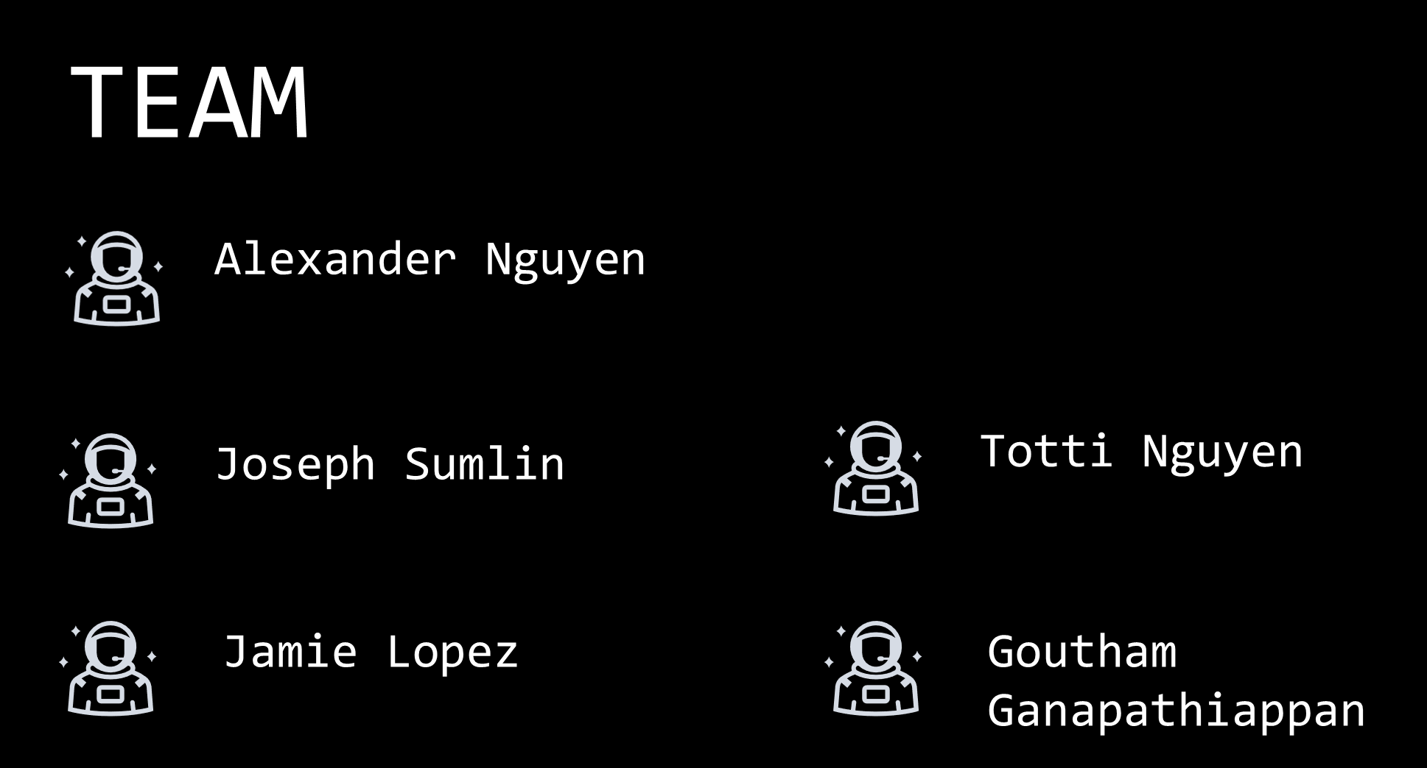

Slide 13
Hangman Game
LOADING….

Slide 14
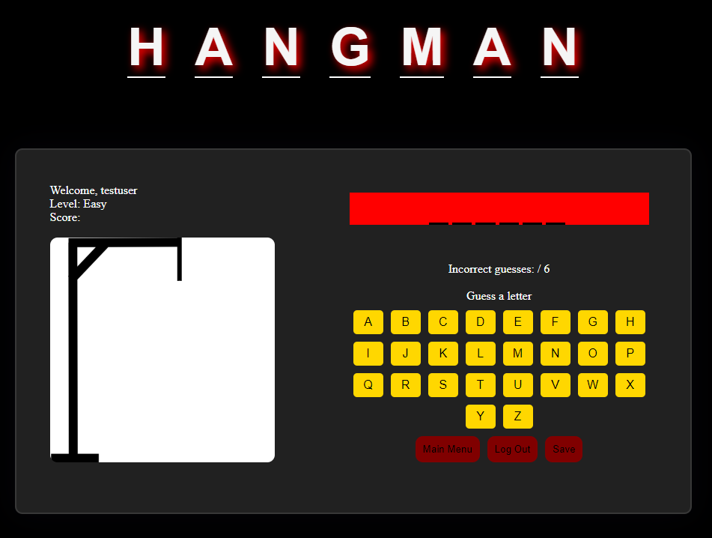
OVERVIEW
What is Hangman?
Hangman is a word guessing game in which a person tries to think of a word, and another tries to guess it by suggesting letters. A part of a stick figure is drawn for each incorrect letter, until the figure is complete.

Slide 15


Key Features
Sign-up/ Login:
The user is asked to sign-up and then login to play the game.
Leaderboard: Based on the users’ scores, they will be ranked and displayed in descending order.
Word Generation: 3 levels of difficulty are presented. Within each level, there are at least 6 different words generated.
Forms Processing: The use of forms was used to store the registration/login information and for the validity of user answers.
Score: The total score is displayed, increasing or decreasing depending on whether the letter/word is guessed or not.

Slide 16
Key Features
Sign-up/ Login:
The user is asked to sign-up and then login to play the game.
Leaderboard: Based on the users’ scores, they will be ranked and displayed in descending order.
Word Generation: 3 levels of difficulty are presented. Within each level, there are at least 6 different words generated.
Forms Processing: The use of forms was used to store the registration/login information and for the validity of user answers.
Score: The total score is displayed, increasing or decreasing depending on whether the letter/word is guessed or not.

Slide 17
Key Features
Sign-up/ Login:
The user is asked to sign-up and then login to play the game.
Leaderboard: Based on the users’ scores, they will be ranked and displayed in descending order.
Word Generation: 3 levels of difficulty are presented. Within each level, there are at least 6 different words generated.
Forms Processing: The use of forms was used to store the registration/login information and for the validity of user answers.
Score: The total score is displayed, increasing or decreasing depending on whether the letter/word is guessed or not.

Slide 18
Key Features
Sign-up/ Login:
The user is asked to sign-up and then login to play the game.
Leaderboard: Based on the users’ scores, they will be ranked and displayed in descending order.
Word Generation: 3 levels of difficulty are presented. Within each level, there are at least 6 different words generated.
Forms Processing: The use of forms was used to store the registration/login information and for the validity of user answers.
Score: The total score is displayed, increasing or decreasing depending on whether the letter/word is guessed or not.

Slide 19
Key Features
Sign-up/ Login:
The user is asked to sign-up and then login to play the game.
Leaderboard: Based on the users’ scores, they will be ranked and displayed in descending order.
Word Generation: 3 levels of difficulty are presented. Within each level, there are at least 6 different words generated.
Forms Processing: The use of forms was used to store the registration/login information and for the validity of user answers.
Score: The total score is displayed, increasing or decreasing depending on whether the letter/word is guessed or not.

Slide 20
Key Features
Sign-up/ Login:
The user is asked to sign-up and then login to play the game.
Leaderboard: Based on the users’ scores, they will be ranked and displayed in descending order.
Word Generation: 3 levels of difficulty are presented. Within each level, there are at least 6 different words generated.
Forms Processing: The use of forms was used to store the registration/login information and for the validity of user answers.
Score: The total score is displayed, increasing or decreasing depending on whether the letter/word is guessed or not.

Slide 21
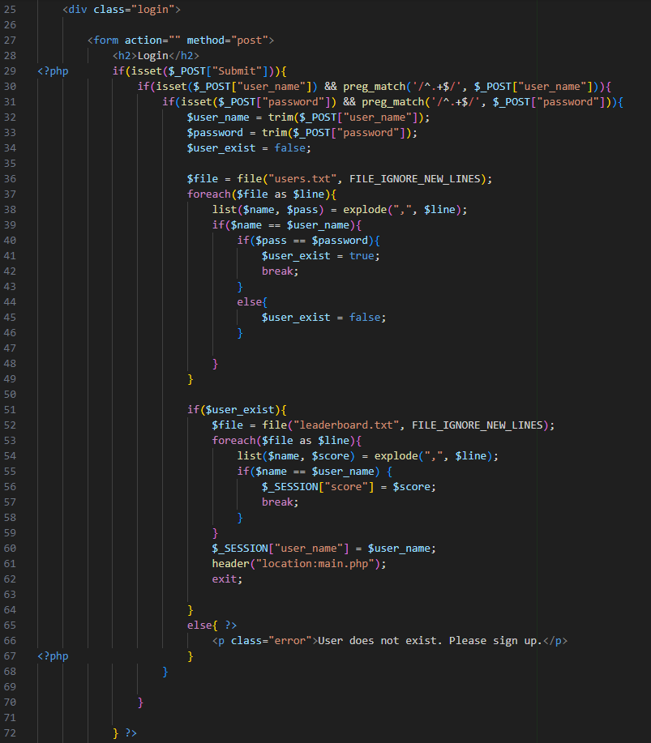
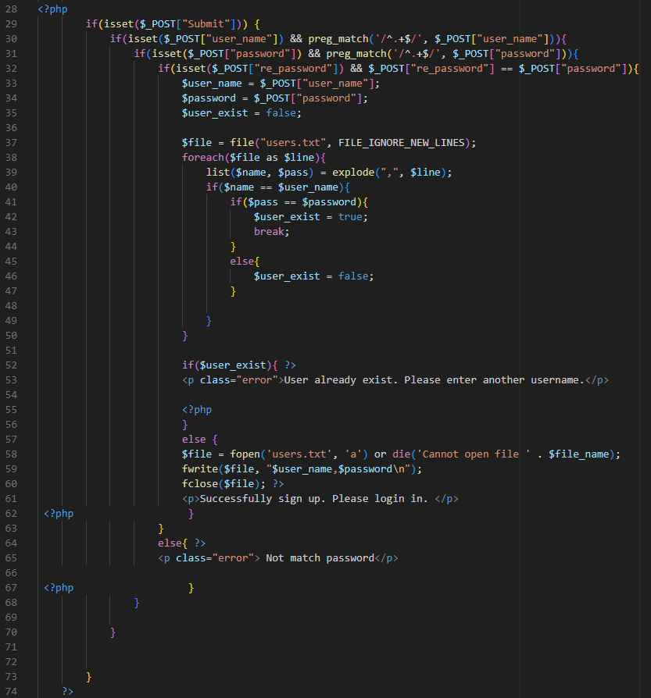
CODE SNIPPETS – LOGIN/SIGN-UP
Login
Sign-Up

Slide 22
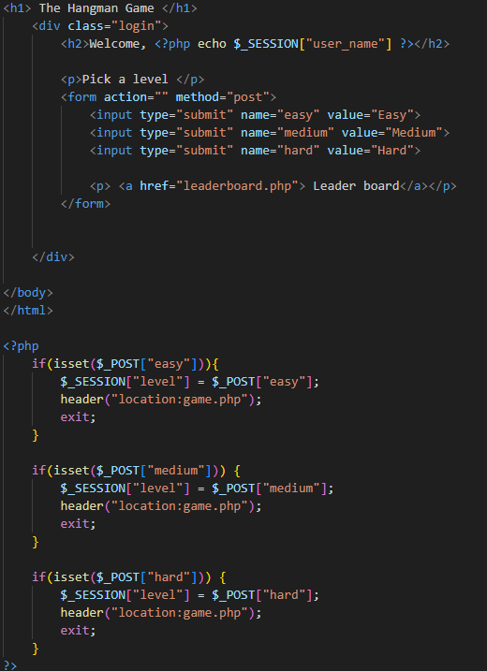
CODE SNIPPETS – MAIN MENU

Slide 23
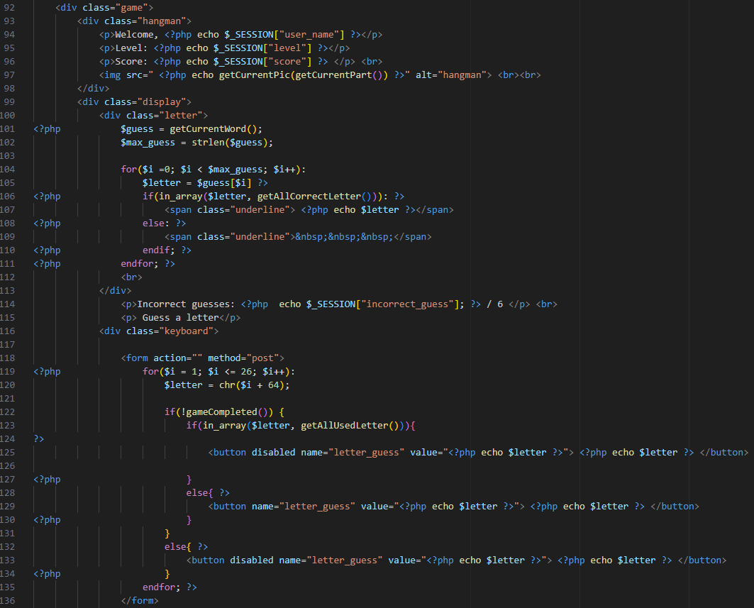
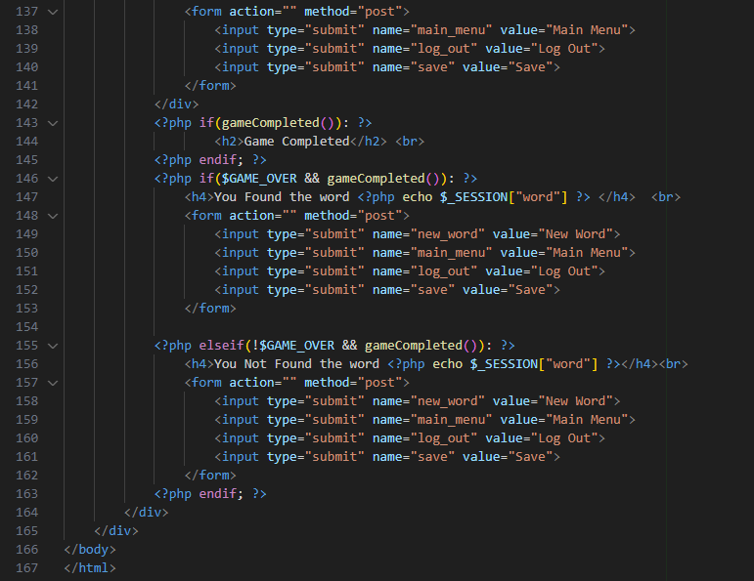
CODE SNIPPETS - GAME

Slide 24
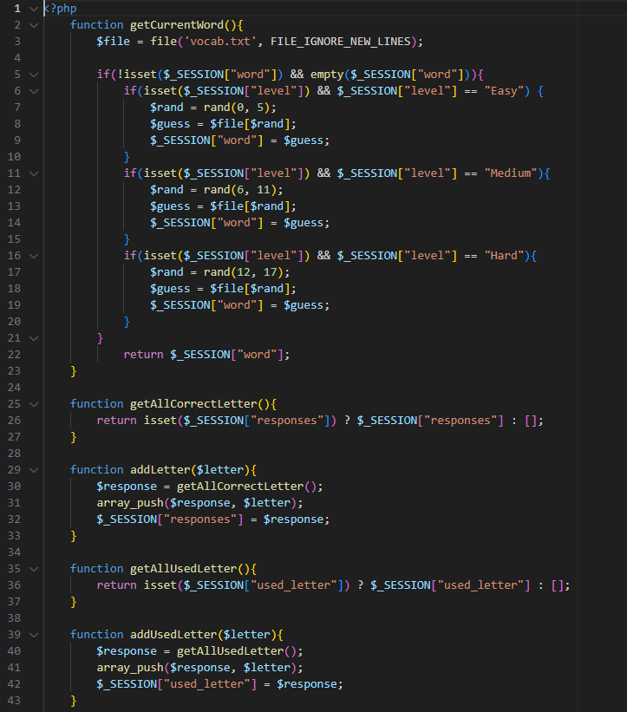
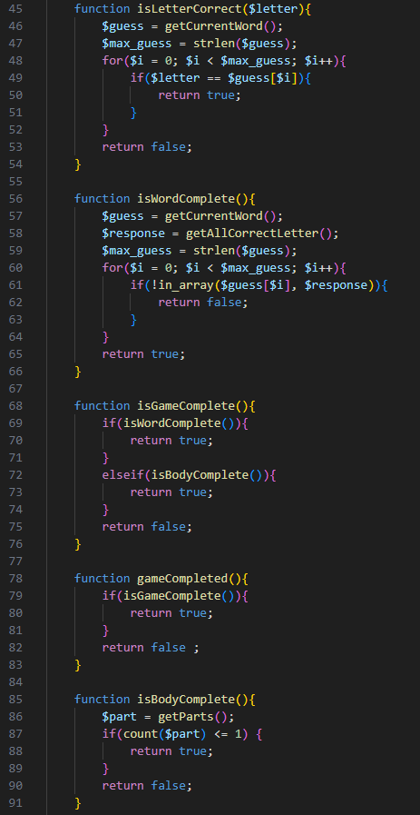
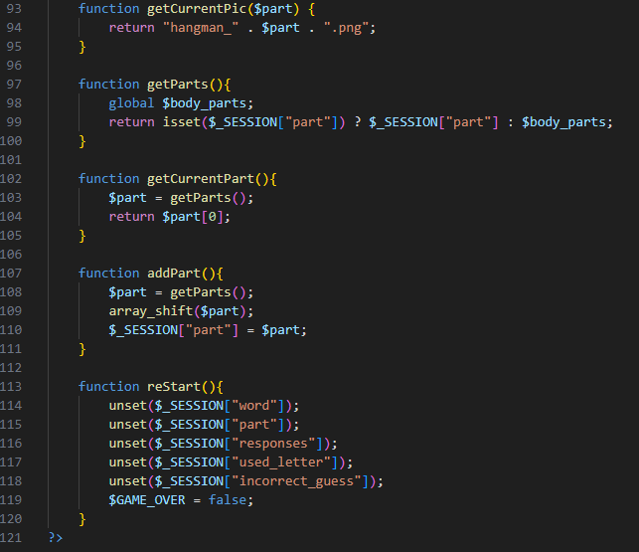
CODE SNIPPETS - GAME

Slide 25
DEMO
Project Link:
https://codd.cs.gsu.edu/~anguyen127/WP/PW/2/login.php

Slide 26
Demo Run

Slide 27
Future Applications

Slide 28
Future Applications
Educational Tool:
The Hangman game can be adapted for educational purposes, helping students enhance their vocabulary and spelling skills. Teachers can create custom word lists related to specific subjects or lessons. As students guess words, they reinforce their understanding of course content in a fun and interactive way.

Slide 29
Future Applications
Educational Tool:
The Hangman game can be adapted for educational purposes, helping students enhance their vocabulary and spelling skills. Teachers can create custom word lists related to specific subjects or lessons. As students guess words, they reinforce their understanding of course content in a fun and interactive way.
Language Learning Platform:
The game can be integrated into language learning platforms to aid learners in practicing new words and improving language skills. By incorporating words relevant to the target language, users can reinforce their understanding of vocabulary, pronunciation, and spelling. Additionally, different difficulty levels can cater to learners at various proficiency levels.

Slide 30
Future Applications
Educational Tool:
The Hangman game can be adapted for educational purposes, helping students enhance their vocabulary and spelling skills. Teachers can create custom word lists related to specific subjects or lessons. As students guess words, they reinforce their understanding of course content in a fun and interactive way.
Language Learning Platform:
The game can be integrated into language learning platforms to aid learners in practicing new words and improving language skills. By incorporating words relevant to the target language, users can reinforce their understanding of vocabulary, pronunciation, and spelling. Additionally, different difficulty levels can cater to learners at various proficiency levels.
Team Building and Icebreaker Activity:
The Hangman game can serve as a team-building or icebreaker activity in corporate settings. During team-building events or training sessions, the game can be customized with industry-specific terminology or company-related words. It provides a lighthearted and engaging way for team members to interact, fostering a positive and collaborative atmosphere.

Slide 31
Summary

Slide 32
Summary
The Hangman Game project is a web-based game developed in PHP, HTML, and CSS, offering three difficulty levels. Users guess a word with a limited number of incorrect guesses allowed. PHP manages word selection, user guesses, and game logic. The game has educational applications for vocabulary improvement, language learning, and can be used as a team-building activity in corporate settings. Overall, it showcases technical skills and versatility for various contexts.

Slide 33
THE SCRUM METHODOLOGY- ALEXANDER
Effective organizational tool
Allows for a common space for team to communicate and hold each other accountable
Promotes efficient project planning
Keeps the team up-to-date on the progress of the project

Slide 34
THE SCRUM METHODOLOGY - JOSEPH

Slide 35
THE SCRUM METHODOLOGY - JAMIE
Allows for improved communication, adaptability and flexibility
Maintains a steady pace of work
By implementing this technique, the work quality is improved for the project

Slide 36
THE SCRUM METHODOLOGY - TOTTI

Slide 37
THE SCRUM METHODOLOGY - GOUTHAM

Slide 38


